Slide 1
Session 4
Deployment models(Part 1)

Slide 2
Objectives
Private cloud
Public cloud

Slide 3
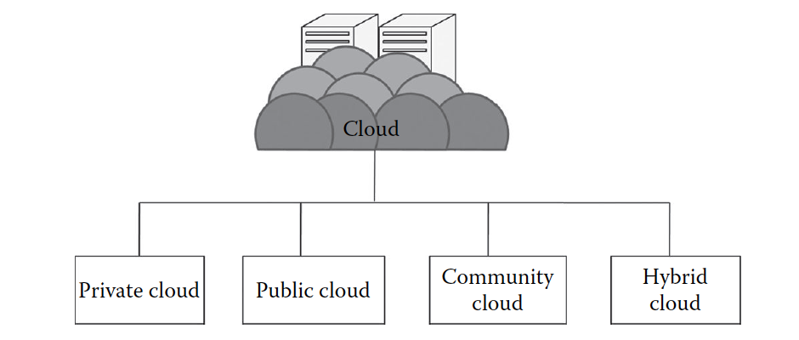
Introduction

Slide 4
Private Cloud’s Characteristics
Secure: Usually the private cloud is deployed and managed by the organization itself, and hence there is least chance of data being leaked out of the cloud.
In the case of outsourced cloud, the service provider may view the cloud (though governed by SLAs), but there is no other risk from anybody else as all the users belong to the same organization.
Central control: The organization mostly has full control over the cloud, private cloud is managed by the organization
Weak SLAs: Formal SLAs may or may not exist in a private cloud
But if they exist they are weak as it is between the organization and the users of the same organization

Slide 5
Private cloud’s Suitability
Require a separate cloud for their personal or official use.
The organizations or enterprises that have a sufficient amount of funds as managing and maintaining a cloud is a costly affair
Consider data security to be important
Want autonomy and complete control over the cloud
Have a less number of users
Have prebuilt infrastructure for deploying the cloud and are ready for timely maintenance of the cloud for efficient functioning
Special care needs to be taken and resources should be available for troubleshooting

Slide 6
The private cloud platform is not suitable for the following
The organizations that have high user base
The organizations that have financial constraints
The organizations that do not have prebuilt infrastructure
The organizations that do not have sufficient manpower to maintain and manage the cloud

Slide 7
Private cloud classification
According to NIST [4], the private cloud can be classified into several types based on their location and management:
On-premise private cloud
Outsourced private cloud

Slide 8
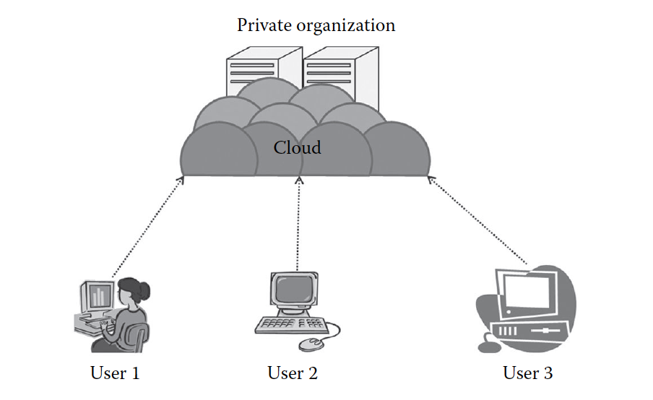
On-Premise Private Cloud
On-premise private cloud is a typical private cloud that is managed by a single organization. Here, the cloud is deployed in organizational premises and is connected to the organizational network

Slide 9
On-Premise Private Cloud issues
Base on the textbook on page 49 explain some issues of On-Premise Private Cloud

Slide 10
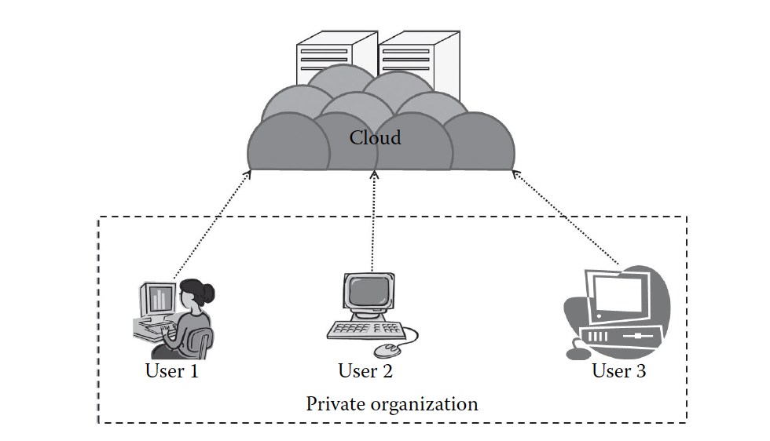
Outsourced Private Cloud
The outsourced private cloud has a cloud outsourced to a third party. A third party manages the whole cloud.
Everything is same as usual private cloud except that here the cloud is outsourced.

Slide 11
Outsourced Private Cloud issues
Comparing outsources private cloud issues with on premise private cloud issues. In you opinion which one is the most important: SLA, Network, Security and privacy, Laws, Location, Performance, Maintenance?

Slide 12
Private cloud’s advantages
The cloud is small in size and is easy to maintain.
It provides a high level of security and privacy to the user.
It is controlled by the organization.

Slide 13
Private cloud’s disadvantages
For the private cloud, budget is a constraint.
The private clouds have loose SLAs.

Slide 14
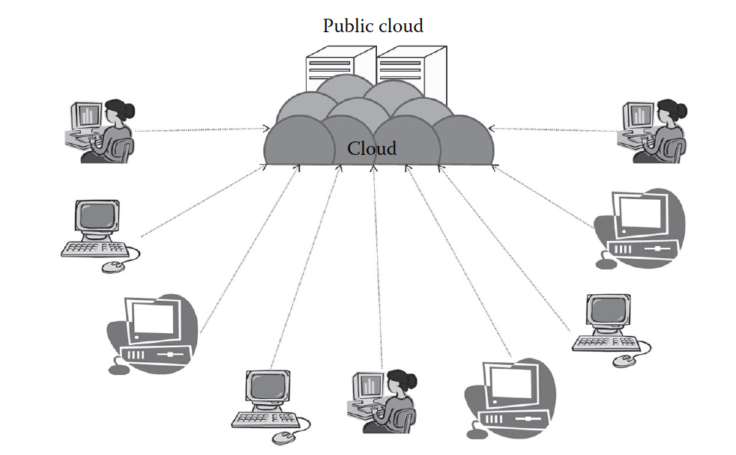
Public Cloud
The public cloud is the cloud infrastructure that is provisioned for open use by the general public. It may be owned, managed, and operated by a business, academic, or government organization, or some combination of them
It exists on the premises of the cloud provider
Some of the well-known examples of the public cloud are Amazon AWS [5], Microsoft Azure [6], etc

Slide 15
Public Cloud’s Characteristics
Highly scalable
The resources in the public cloud are large in number and the service providers make sure that all the requests are granted
Affordable:
The public cloud is offered to the public on a pay-as-you-go basis; hence, the user has to pay only for what he or she is using
Less secure
The public cloud is less secure out of all the four deployment models. This is because the public cloud is offered by a third party and they have full control over the cloud. Though the SLAs ensure privacy, still there is a high risk of data being leaked

Slide 16
Public Cloud’s Characteristics
Highly available: The public cloud is highly available because anybody from any part of the world can access the public cloud with proper permission, and this is not possible in other models as geographical or other access restrictions might be there
Stringent SLAs: Providers follow the SLA strictly and violations are avoided. These SLAs are very competitive

Slide 17
Public Cloud’s Suitability
The requirement for resources is large, that is, there is large user base
The requirement for resources is varying
There is no physical infrastructure available
An organization has financial constraints

Slide 18
The public cloud is not suitable, where the following applies
Security is very important.
Organization expects autonomy
Third-party reliability is not preferred

Slide 19
Public Cloud’s Issues
Students work in group to discuss those issues, the factors can be found on page 54 of the book

Slide 20
Public Cloud’s advantages
There is no need of establishing infrastructure for setting up a cloud.
There is no need for maintaining the cloud.
They are comparatively less costly than other cloud models.
Strict SLAs are followed.
There is no limit for the number of users.
The public cloud is highly scalable

Slide 21
Public Cloud’s disadvantages
Security is an issue.
Privacy and organizational autonomy are not possible.

Slide 22
Summary
The types and characteristics of
Private cloud
On Premise private cloud
Outsourced private cloud
Public cloud

Slide 23
References

